Slide 1
Agile Technology
Software development
BY:K.Arunganessh,P.Balamanikandan
Paavai Engineering College
Pre-Final Year

Slide 2
INTRODUCTION
What’s Agility?
Why Agility?
Agile Manifesto and Principles
What’s Methodology and why?
Methodologies that promote agility
Conclusion

Slide 3
AGILITY
Being agile
Quickness
Swiftness

Slide 4
AGILE
Process has to be lightweight and sufficient
Lightweight helps us adapt and move
Sufficient recognizes our ineffectiveness to be
complete and relies on strong communication

Slide 5
SOFTWARE DEVELOPMENT USING AGILE
Relatively nascent field in comparison
Machines are getting faster or more
Powerful
Are we getting better in delivering
software applications though

Slide 6
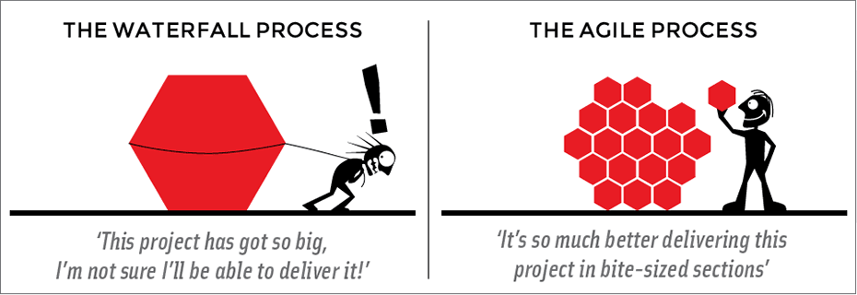
SUCCESS OR FAILURE ???
Less than 10% of software projects
Succeed
Criteria for success?: On time, within
budget, feature complete, works (failure
free)

Slide 7
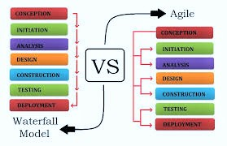
WATERFALL VS AGILE
There is always a comparison between Waterfall & Agile Model.Inthat Agile Stands up than Waterfall model. In Waterfall model if there any change need to be preformed it should be performed from first. But in Agile it's not like that. The Agile is more efficient than Waterfall Model. The Agile Model is now slowly Stepping into India. It is cost efficent.In this any process can be changed in-between.

Slide 8
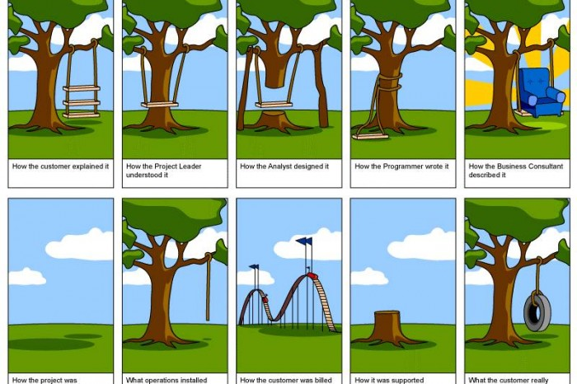
WATERFALL PROCESS DROWNTRODEN
Waterfall approach4- Actually specified iteration - largely ignored
Customer's mind is not frozen after they
give us the requirement for only development

Slide 9
WATERFALL DROWNTRODEN STEPS
The Customer tells how should be the project
How the project manager understood it
How the analyst designed it.
How the programmer made it.
How the Consultant described it.
What operation was installed.
How much was cost
How it was supported
At last how it was delivered to customer

Slide 10
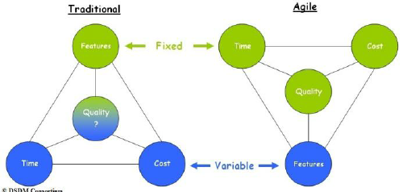
PROJECT MANAGEMENT COMPARASION
* In Agile Time,Cost,Quality are same it can not be changed. Only Features can be changed in-between the project.
*In Traditional Feature is only fixed & Quality,Cost,Time can be changed

Slide 11
AGILE DEVELOPMENT PROCESS
• Iterative and evolutionary development
• Time boxing
–Set amount of time for iteration
–Adapt future iteration based on the realities
• Adaptive planning
• Incremental delivery
• Agility
• More focused on success than sticking
with a plan
• Working software is valued and
considered measure of progress

Slide 12
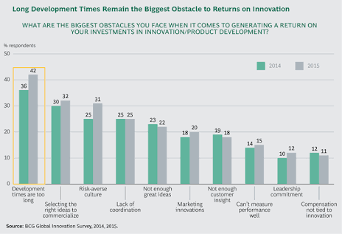
FUTURE OF AGILE
IN FUTURE Agile Plays a major role in Software Development. Compared to all other Software Development Process.
It has a great hike in-between 2014 to 2015

Slide 13
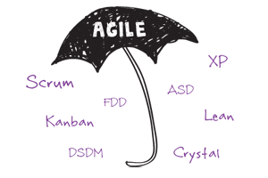
AGILE METHODS

Slide 14
METHODOLOGIES
Methodologies share common principles,
but differ in practices
• eXtreme Programming (XP)
• Scrum
• Evolutionary Project Management (Evo)
• Unified Process (UP)
• Crystal
• Lean Development (LD)
• Adaptive Software Development (ASD)
• Dynamic System Development Method (DSDM)
• Feature Driven Development (FDD)

Slide 15
COMPARASION OF METHODOLOGY
 | XP | SRUM | EVO
ITERATION | 2/3 WEEKS | 30 DAYS | 5 DAYS
CUSTOMER PARTICIPATION | STRONG | STRONG | WEAK
BUSINESS PROCESS | MEDIUM | HIIGH | LOW

Slide 16
ADVANTAGE OF AGILE
• Cost
– Too little, does not solve problems
– Too much, some times more of a problem
• Time
– More time can improve quality and increase
• scope
– Too much time hurts as well
• Quality
– Sacrificing this may result in short term gains
– Over the long haul, lost is enormous

Slide 17
• Communication
– Communicate critical change in requirements, design, etc.
- Put in place practices that will enhance communication Simplicity
– Find simplest thing that will work
– Build some thing simple today and pay a little to change tomorrow than build some thing complicated today that may never be used
• Scope
– Lesser the scope, better the quality
– You can deliver sooner as well
– Assuming it meets the business needs

Slide 18
CONCLUSION
Agile models are based on iterative software development. An independent working module is built after the completion of iteration. Iteration should not consume more than two weeks to complete a code. Agile methodologies invite the developers to get involved in testing, rather than a separate quality assurance team.
Agile methodologies are suitable in changing environments because of new practices and principles that enable a team to develop a product in short duration

